Slide 1

Identifying Neighbourhood in Central Delhi for Opening a Restaurant
Ranjeet kumar
27 march 2020

Slide 2
Introduction
Background
New Delhi is India's capital and a hub of tourists attracting thousands of tourists every day. Population density in New Delhi is about 19,300 Delhiites per square mile (7,400 per square kilometre). It is primarily divided into multiple districts Central Delhi, East Delhi, New Delhi, North Delhi, North East Delhi, North West Delhi, South Delhi, South West Delhi, West Delhi.
New Delhi presents itself as wonderful location for profitable businesses including restaurants.
Problem
A Food & Beverage entrepreneur is looking for a suitable location in Central Delhi to open a new restaurant to expand their business. Currently company has restaurants opened in other cities of India. Client is particularly interested to identify a suitable neighbourhood in Central Delhi for restaurant business.
I will focus this analysis on identifying the neighbourhoods where business will be good with less competition. Objective is to short list 4-5 such places so that client can decide the best once based on other factors.
Target Audience
Any entrepreneur interested in opening up a restaurant in Central Delhi

Slide 3
Data acquisition and cleaning
First Dataset: List of all the neighbourhoods in Central Delhi : https://zip.nowmsg.com/city.asp?country=IN&state=Delhi&county=Central%20Delhi
Data available on this site contains lists of all places in Central Delhi and their Postal code, Place Name, Community, Country, State, Latitude, Longitude and a link to map.
Second Dataset: Foursquare location data to explore different venues in each neighborhood of Central Delhi
Used BeautifulSoup to scrap the page and get a table with four columns: Ward, District, Latitude and Longitude
In total, 1137 neighborhood details collected
Duplicate, highly similar or highly correlated features were dropped.
Cleaned data contains neighborhood, Latitude, Longitude, Venue, Venue Category

Slide 4
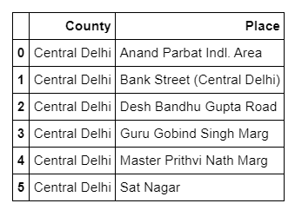
Methodology & analysis
Web scraped data from source
Fetched Foursquare venue data for the dataset
Analyzed venue data received
Used K-Means clustering algorithm to make clusters of the neighborhoods for further analysis
Created 5 clusters out of which only one was to be selected for further analysis
Cluster with label 1 was selected as it had lowest Restaurant/Neighborhood ratio for that cluster
After further analysis, only 6 neighborhoods remained which were perfect for opening up a new restaurant.

Slide 5
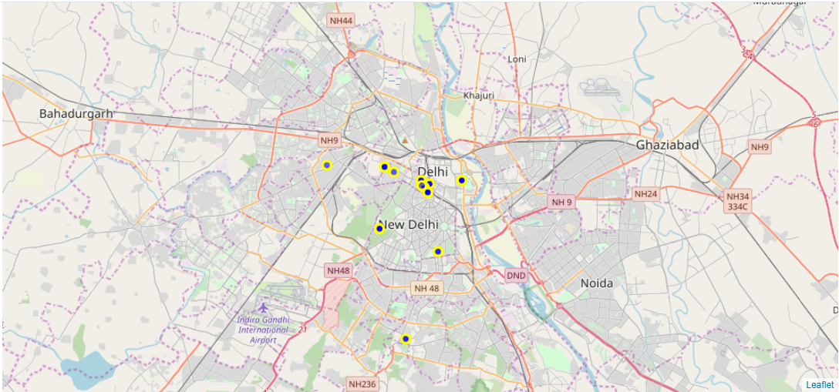
FOLIUM for visualization
A map of Central Delhi was generated using a visualisation library - Folium. All the neighbourhoods of Central Delhi have been marked on the map.

Slide 6
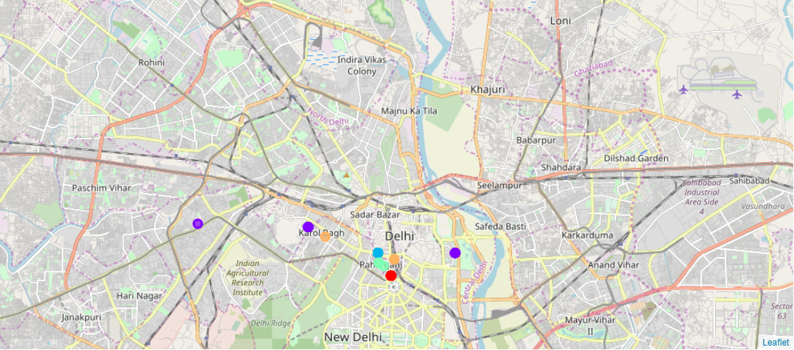
FOLIUM for visualization
After using the clustering algorithm and creating 5 different clusters where each neighbourhood belong to one of these clusters. 5 different colours, one for each cluster are used for representing each neighbourhood in Central Delhi.

Slide 7
Conclusion
Identified neighbourhoods in Central Delhi with least restaurant density making the place ideal for new restaurant business due to lower competition
6 neighbourhoods identified in Central Delhi
Accuracy of the models has room for improvement.
Ideas include:
Population density of each neighbourhood
Ethnicity analysis
Demographic study

